Slide 1
Oral Enalish Presentation Skills
Final Assignment
Family History Presentation
Professor Thayer
Eason
Student lD 3123358222
Spring Semester 2024

Slide 2
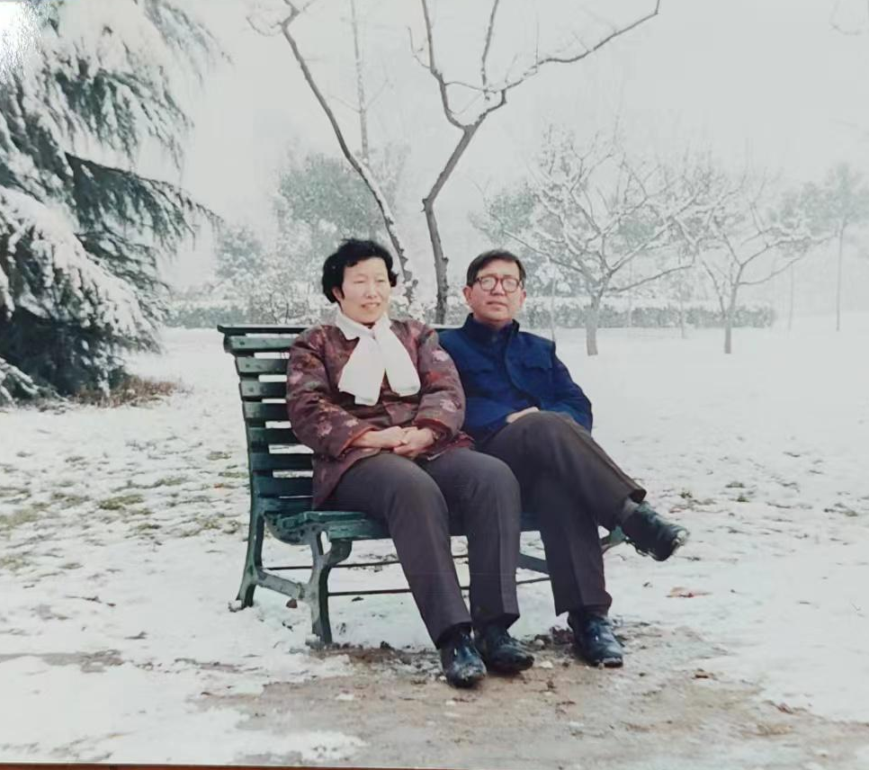
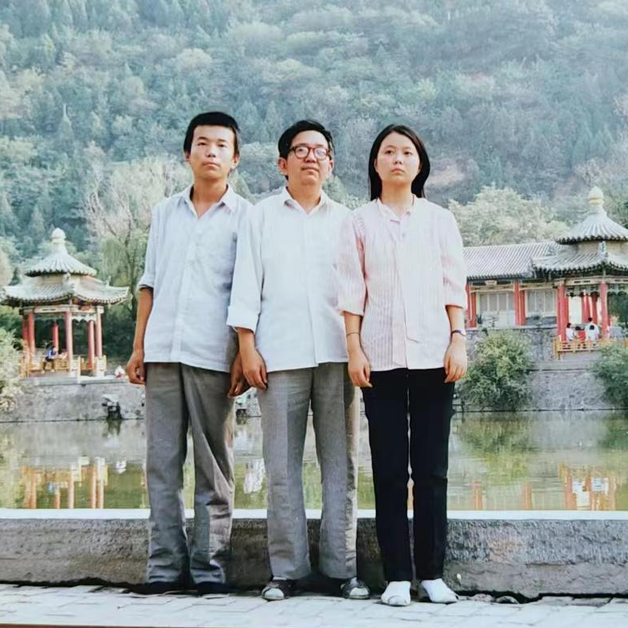
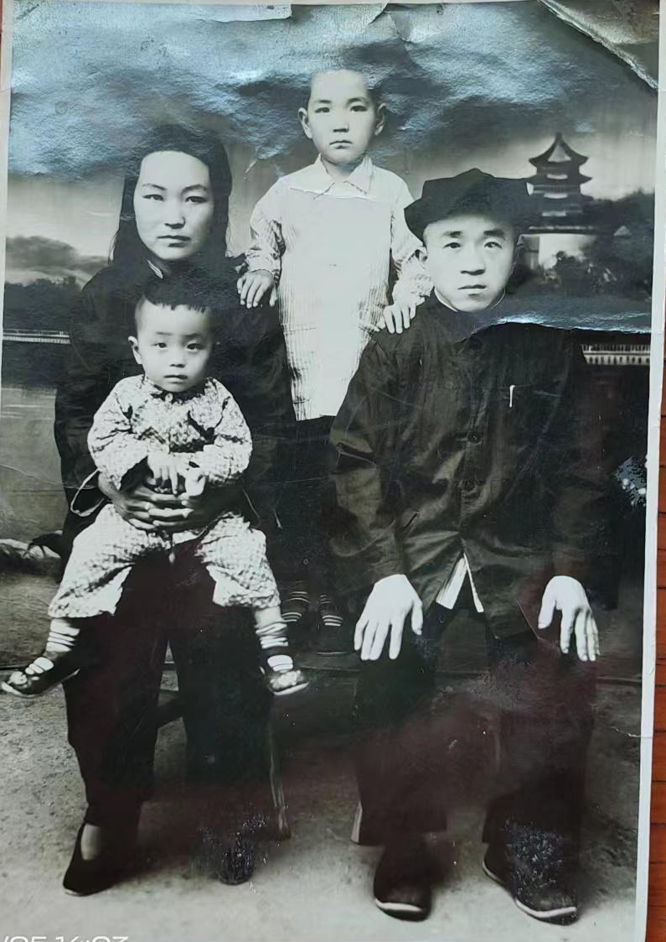
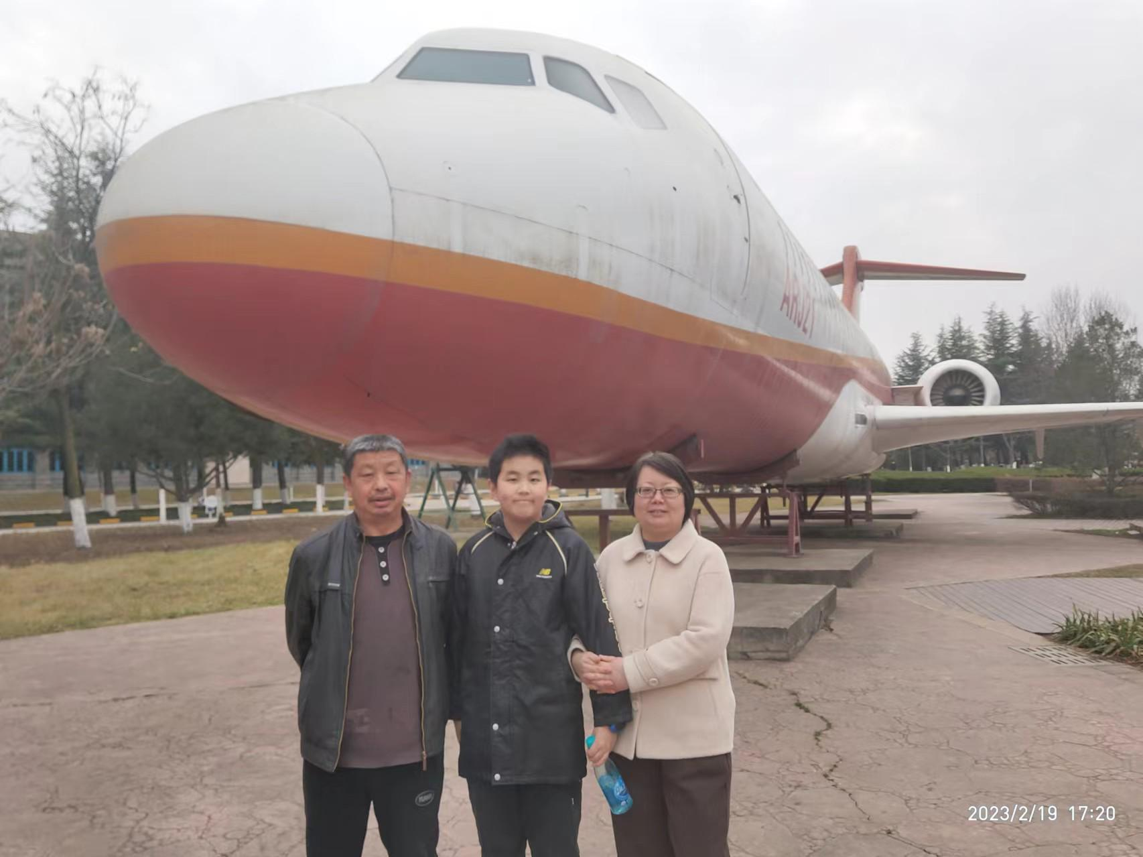
My Grand-
grandparents
My grandparents
My mom and uncle
王广增 & 朱桂华
王慧芳 & 王志刚
王开文 & 秦桂兰
My father and mother
王慧芳 & 吴世贵

Slide 3
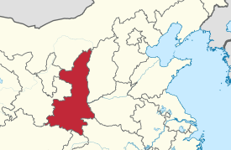
My Grand-grandparents came from Henan province
Shaanxi province
Henan province

Slide 4
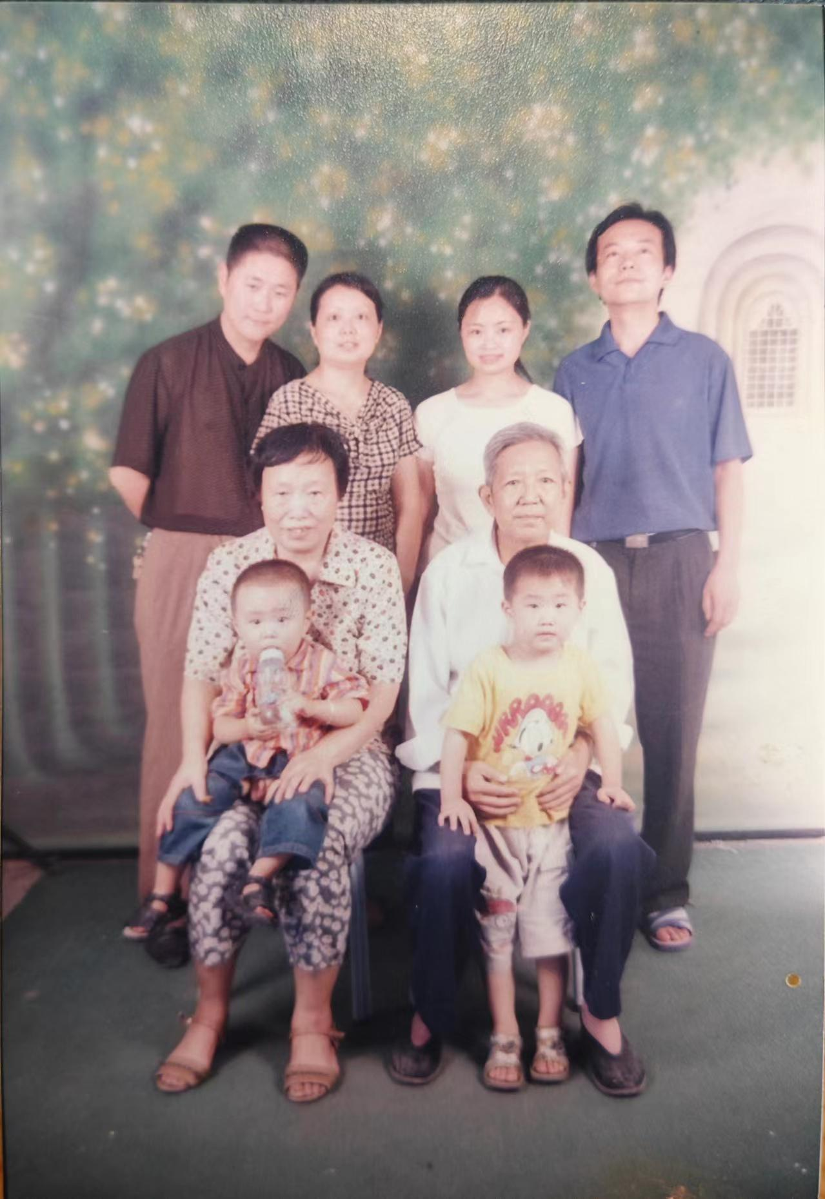

Slide 5
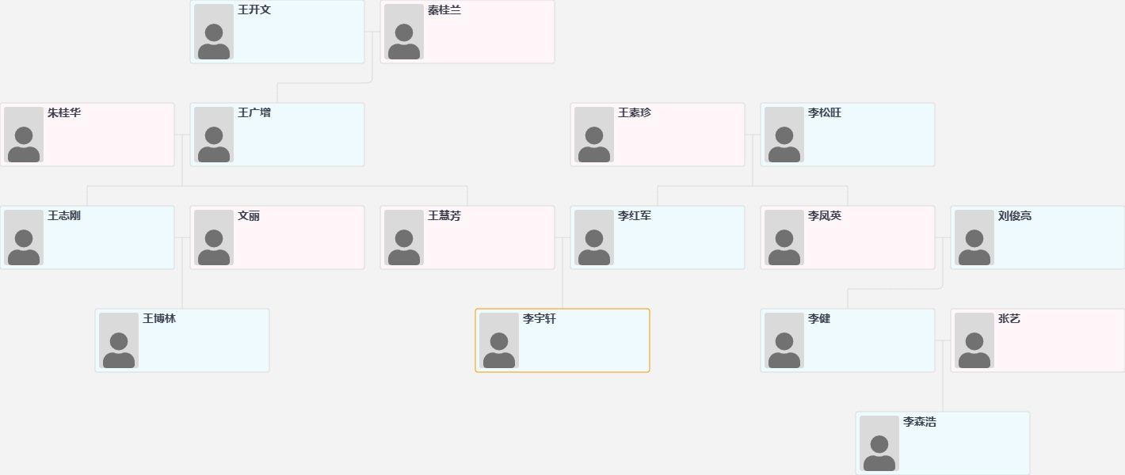

Slide 6
Oral Enalish Presentation Skills
Thanks for listening！
Eason
Student lD 3123358222
Spring Semester 2024

